Slide 1
BASIC COMPUTER ORGANIZATION
Computer Organization and Assembly Language
Computer Science Department
National University of Computer and Emerging Sciences Islamabad

Slide 2
OVERVIEW
Basic Computer Organization
IA-32 Registers
Intel Microprocessors
Instruction Execution Cycle
IA-32 Memory Management

Slide 3
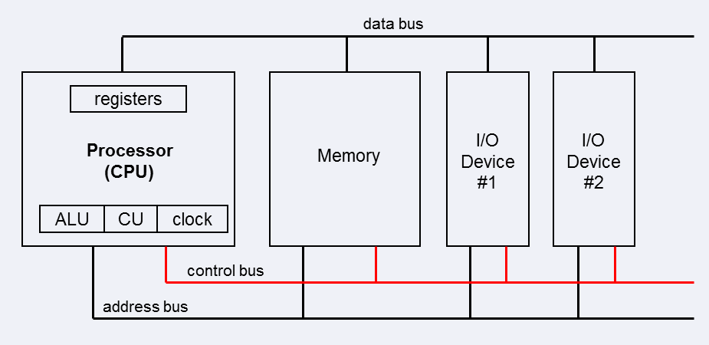
BASIC COMPUTER ORGANIZATION
Since the 1940's, computers have 3 classic components:
  Processor, called also the CPU (Central Processing Unit)
  Memory and Storage Devices
  I/O Devices
Interconnected with one or more buses
Bus consists of
  Data Bus
  Address Bus
  Control Bus

Slide 4
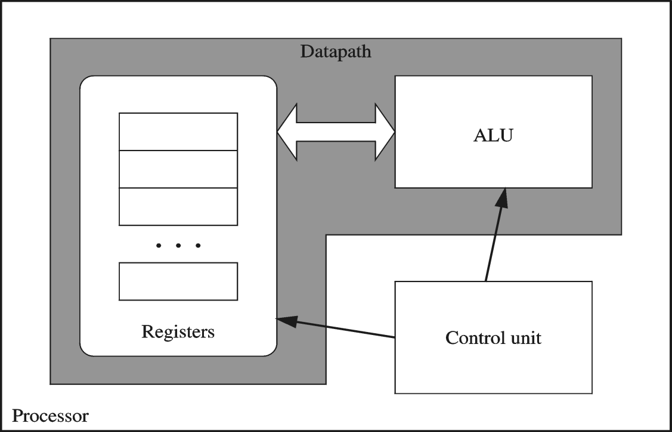
PROCESSOR
Processor consists of
  Datapath
    ALU
    Registers
  Control unit
ALU
  Performs arithmetic
  and logic instructions
Control unit (CU)
  Generates the control signals required to execute instructions
Implementation varies from one processor to another

Slide 5

STRUCTURE - TOP LEVEL
Peripherals
Computer
Central
Processing
Unit
Main
Memory
Computer
Systems
Interconnection
Input
Output
Communication
lines

Slide 6
STRUCTURE - THE CPU
CPU
Computer
Arithmetic
and
Logic Unit
I/O
Registers
System
Bus
CPU
Internal CPU
Interconnection
Memory
Control
Unit

Slide 7

STRUCTURE - THE CONTROL UNIT
Control Unit
CPU
ALU
Sequencing
Logic
Internal
Bus
Control
Unit
Control Unit
Registers and
Decoders
Registers
Control
Memory

Slide 8
CLOCK
Synchronizes Processor and Bus operations
Clock cycle = Clock period = 1 / Clock rate
Clock rate = Clock frequency = Cycles per second
  1 Hz = 1 cycle/sec 1 KHz = 10³ cycles/sec
  1 MHz = 10⁶ cycles/sec 1 GHz = 10⁹ cycles/sec
  2 GHz clock has a cycle time = 1/(2×10⁹) = 0.5 nanosecond (ns)
Clock cycles measure the execution of instructions
Cycle 1
Cycle 2
Cycle 3
Notes:
Clock period is defined as the time represented by one clock cycle.

Slide 9
NEXT ...
Basic Computer Organization
IA-32 Registers
Intel Microprocessors
Instruction Execution Cycle
IA-32 Memory Management

Slide 10
BASIC PROGRAM EXECUTION REGISTERS
Registers are high speed memory inside the CPU
  Eight 32-bit general-purpose registers
  Six 16-bit segment registers
  Processor Status Flags (EFLAGS) and Instruction Pointer (EIP)
32-bit General-Purpose Registers
EAX
EBP
EBX
ESP
ECX
ESI
EDX
EDI
16-bit Segment Registers
EFLAGS
CS
ES
SS
FS
EIP
DS
GS

Slide 11
GENERAL-PURPOSE REGISTERS
Used primarily for arithmetic and data movement
  mov eax, 10 move constant 10 into register eax
Specialized uses of Registers
  EAX – Accumulator register
    Automatically used by multiplication and division instructions
  ECX – Counter register
    Automatically used by LOOP instructions
  ESP – Stack Pointer register
    Used by PUSH and POP instructions, points to top of stack
  ESI and EDI – Source Index and Destination Index register
    Used by string instructions
  EBP – Base Pointer register
    Used to reference parameters and local variables on the stack

Slide 12



ACCESSING PARTS OF REGISTERS
EAX, EBX, ECX, and EDX are 32-bit Extended registers
  Programmers can access their 16-bit and 8-bit parts
  Lower 16-bit of EAX is named AX
  AX is further divided into
    AL = lower 8 bits
    AH = upper 8 bits
ESI, EDI, EBP, ESP have only
16-bit names for lower half

Slide 13
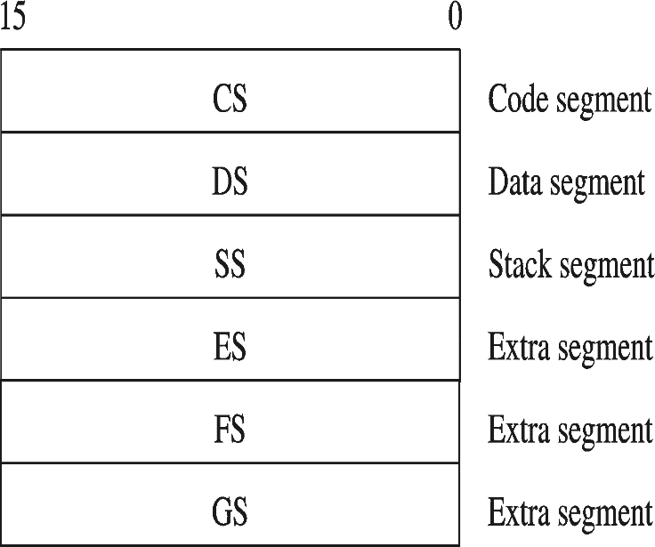
SPECIAL-PURPOSE & SEGMENT REGISTERS
EIP = Extended Instruction Pointer
  Contains address of next instruction to be executed
EFLAGS = Extended Flags Register
  Contains status and control flags
  Each flag is a single binary bit
Six 16-bit Segment Registers
  Support segmented memory
  Six segments accessible at a time
  Segments contain distinct contents
    Code
    Data
    Stack

Slide 14
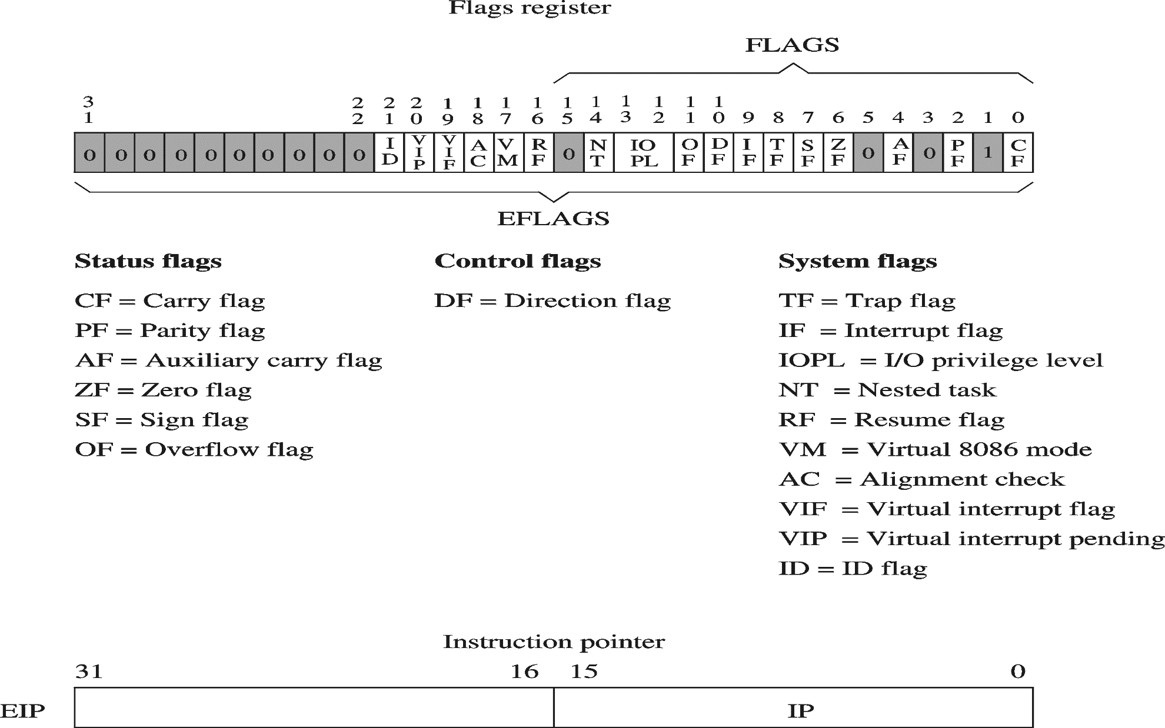
EFLAGS REGISTER
Status Flags
  Status of arithmetic and logical operations
Control and System flags
  Control the CPU operation
Programs can set and clear individual bits in the EFLAGS register

Slide 15
STATUS FLAGS
Carry Flag
  Set when unsigned arithmetic result is out of range
Overflow Flag
  Set when signed arithmetic result is out of range
Sign Flag
  Copy of sign bit, set when result is negative
Zero Flag
  Set when result is zero
Auxiliary Carry Flag
  Set when there is a carry from bit 3 to bit 4
Parity Flag
  Set when parity is even
  Sums the number of bits that are set in a number, and indicates whether the sum is odd or even
Notes:
In computer processors the parity flag indicates if the number of set bits is odd or even in the binary representation of the result of the last operation. It is normally a single bit in a processor status register.
For example, assume a machine where a set parity flag indicates even parity. If the result of the last operation were 26 (11010 in binary), the parity flag would be 0 since the number of set bits is odd. Similarly, if the result were 102 (1100110 in binary) then the parity flag would be 1

Slide 16

FLOATING-POINT, MMX, XMM REGISTERS
Floating-point unit performs high speed FP operations
Eight 80-bit floating-point data registers
  ST(0), ST(1), . . . , ST(7)
  Arranged as a stack
  Used for floating-point arithmetic
Eight 64-bit MMX registers
  Used with MMX instructions
Eight 128-bit XMM registers
  Used with SSE instructions
Notes:
MMX-Single Intruction,Multiple Data (SIMD)
SSE-Streaming SIMD Extensions (SSE)

Slide 17
NEXT ...
Basic Computer Organization
IA-32 Registers
Intel Microprocessors
Instruction Execution Cycle
IA-32 Memory Management

Slide 18
MEMORY
Ordered sequence of bytes
  The sequence number is called the memory address
Byte addressable memory
  Each byte has a unique address
  Supported by almost all processors
Physical address space
  Determined by the address bus width
  Pentium has a 32-bit address bus
    Physical address space = 4GB = 2³² = 4000 000 000 bytes
  Itanium with a 64-bit address bus can support
    Up to 2⁶⁴ bytes of physical address space

Slide 19
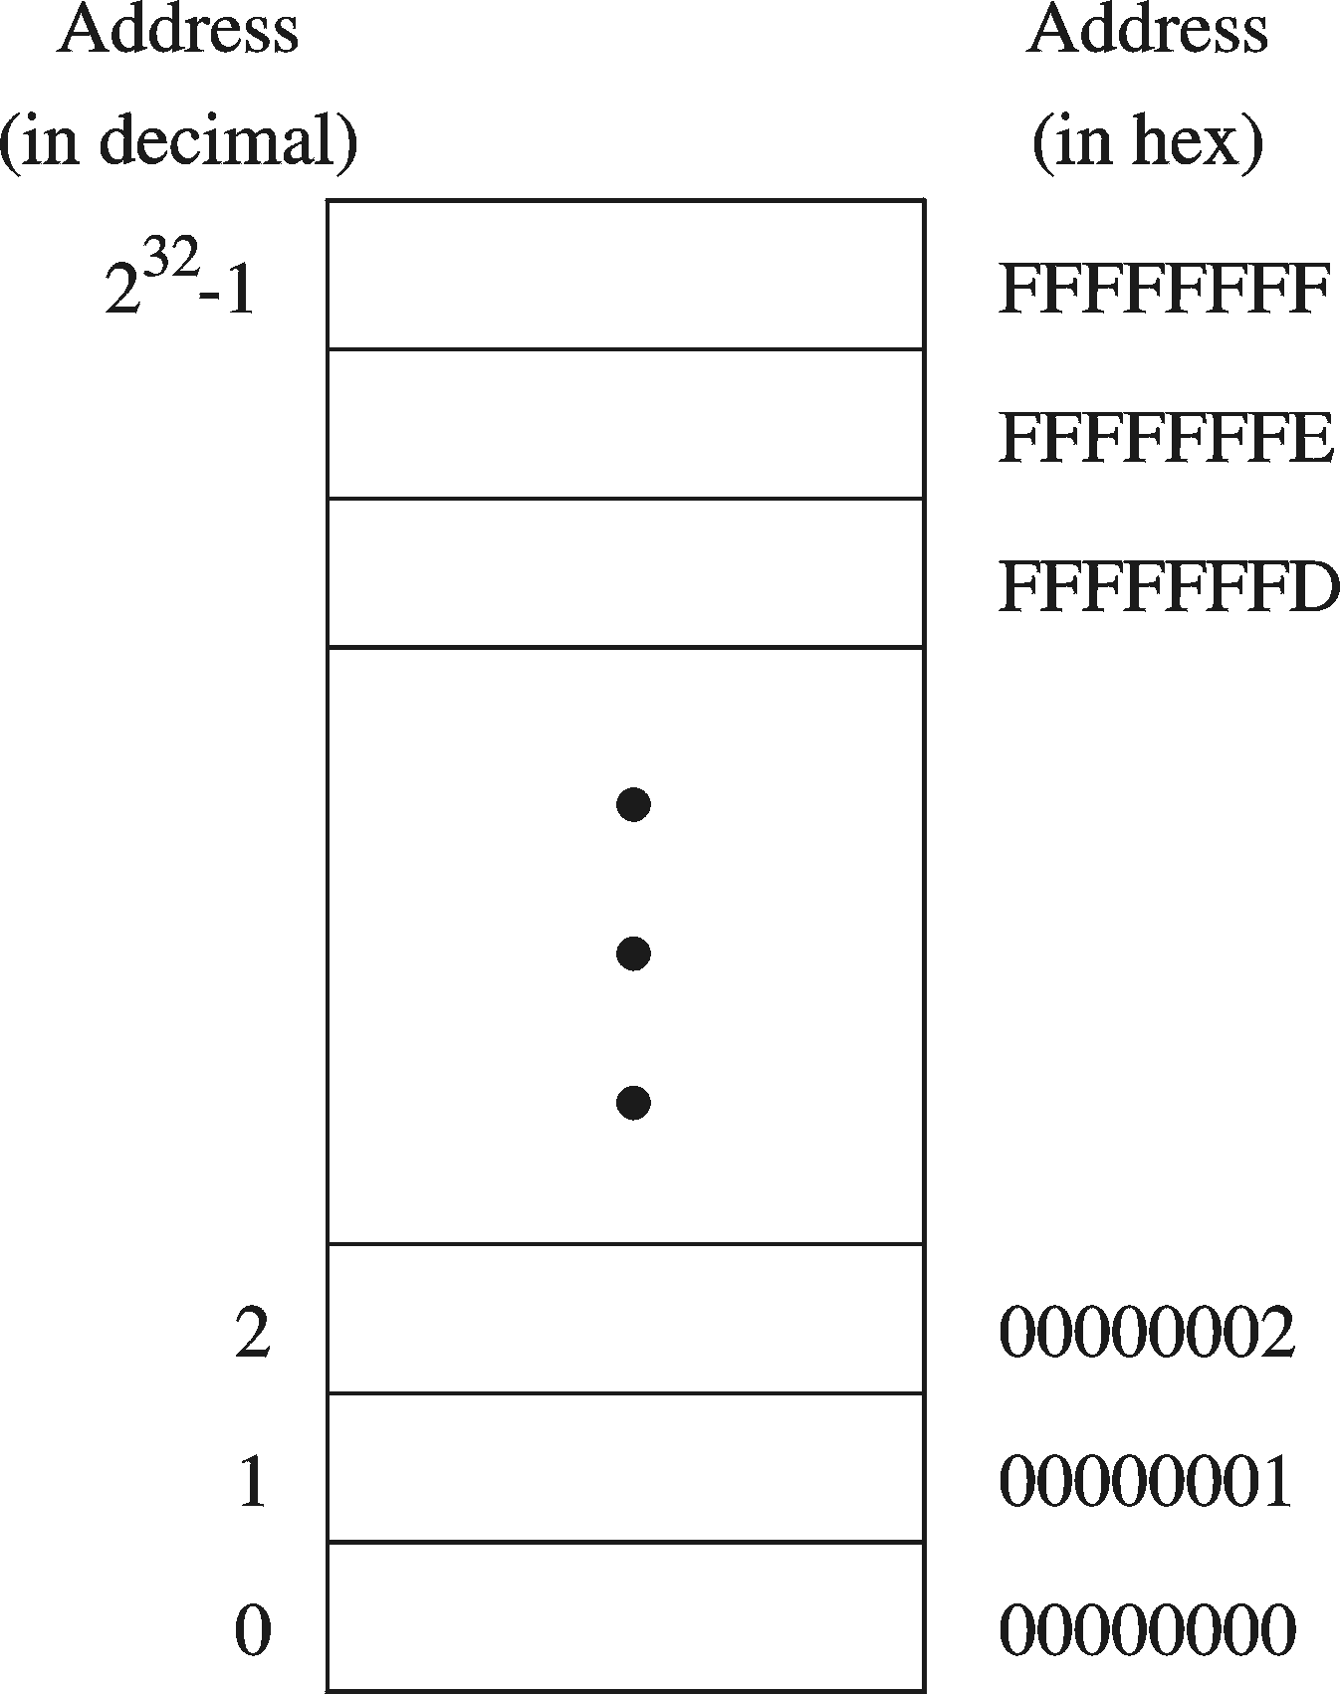
ADDRESS SPACE
Address Space is the set of memory locations (bytes) that can be addressed

Slide 20
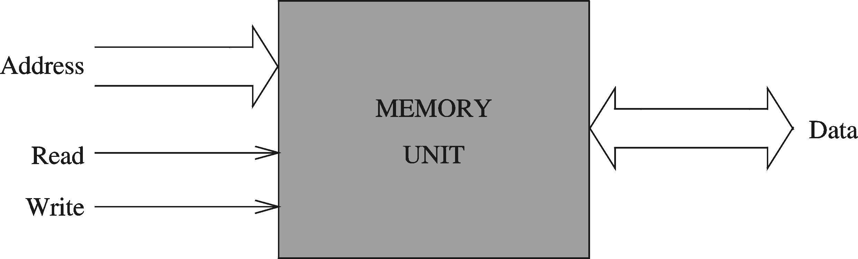
MEMORY UNIT
Two Control Signals
  Read
  Write
  Control whether memory should be read or written
Address Bus
  Address is placed on the address bus
  Address of location to be read/written
Data Bus
  Data is placed on the data bus

Slide 21
MEMORY READ AND WRITE CYCLES
Read cycle
  Processor places address on the address bus
  Processor asserts the memory read control signal
  Processor waits for memory to place the data on the data bus
  Processor reads the data from the data bus
  Processor drops the memory read signal
Write cycle
  Processor places address on the address bus
  Processor asserts the memory write control signal
  Processor places the data on the data bus
  Wait for memory to store the data (wait states for slow memory)
  Processor drops the memory write signal

Slide 22
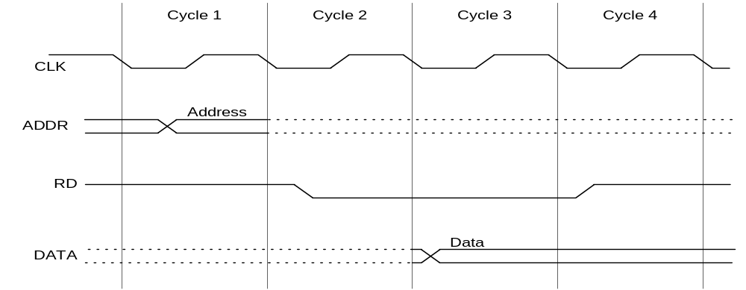
READING FROM MEMORY
Multiple clock cycles are required
Memory responds much more slowly than the CPU
  Address is placed on address bus
  Read Line (RD) goes low, indicating that processor wants to read
  CPU waits (one or more cycles) for memory to respond
  Read Line (RD) goes high, indicating that data is on the data bus

Slide 23
LITTLE ENDIAN ORDER
Little endian order refers to the way Intel stores integers in memory.
Multi-byte integers are stored in reverse order, with the least significant byte stored at the lowest address
For example, the doubleword 12345678h would be stored as:
Byte | Offset
78 | 0000
56 | 0001
34 | 0002
12 | 0003
When integers are loaded from memory into registers, the bytes are automatically re-reversed into their correct positions.
Notes:
Reason: more consistent for variable length (e.g., 2 bytes, 4 bytes, 8 bytes…etc.)

Slide 24
BIG ENDIAN ORDER
The Most significant byte stored at the lowest address
For example, the doubleword 12345678h would be stored as:
Byte | Offset
12 | 0000
34 | 0001
56 | 0002
78 | 0003

Slide 26
MEMORY DEVICES
ROM = Read-Only Memory
  Stores information permanently (non-volatile)
  Used to store the information required to startup the computer
  Many types: ROM, EPROM, EEPROM, and FLASH
  FLASH memory can be erased electrically in blocks
RAM = Random Access Memory
  Volatile memory: data is lost when device is powered off
  Dynamic RAM (DRAM)
    Inexpensive, used for main memory, must be refreshed constantly
  Static RAM (SRAM)
    Expensive, used for cache memory, faster access, no refresh
  Video RAM (VRAM)
    Dual ported: read port to refresh the display, write port for updates
Notes:
SRAM is more expensive, but faster and significantly less power hungry (especially idle) than DRAM. It is therefore used where either bandwidth or low power, or both, are principal considerations. SRAM is also easier to control (interface to) and generally more truly random access than modern types of DRAM. Due to a more complex internal structure, SRAM is less dense than DRAM and is therefore not used for high-capacity, low-cost applications such as the main memory in personal computers.
Reference Chapter#5

Slide 27
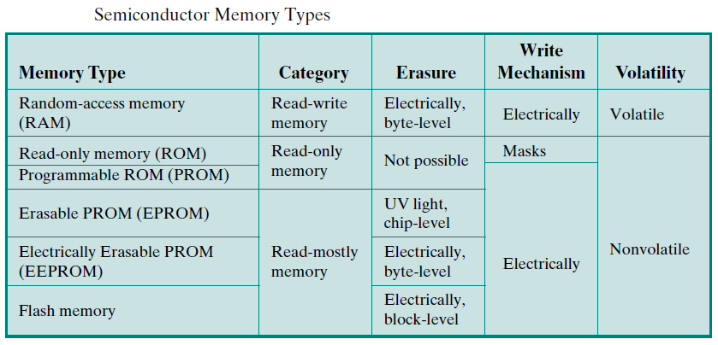
MEMORY DEVICES

Slide 28
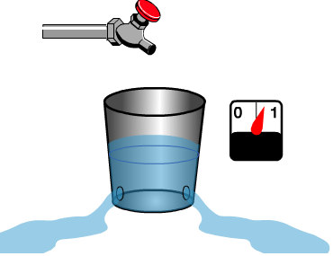
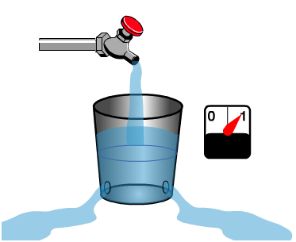
MOST RAM MUST BE RECHARGED CONSTANTLY
Volatile Memory losses contents when power is removed

Slide 29
MEMORY HIERARCHY
Registers
  Fastest storage elements, stores most frequently used data
  General-purpose registers: accessible to the programmer
  Special-purpose registers: used internally by the microprocessor
Cache Memory
  Fast SRAM that stores recently used instructions and data
  Recent processors have 2 and 3 levels
Main Memory (DRAM)
Disk Storage
  Permanent magnetic
  storage for files
registers
cache memory
higher speed, smaller size
lower cost per byte
main memory
disk storage

Slide 30
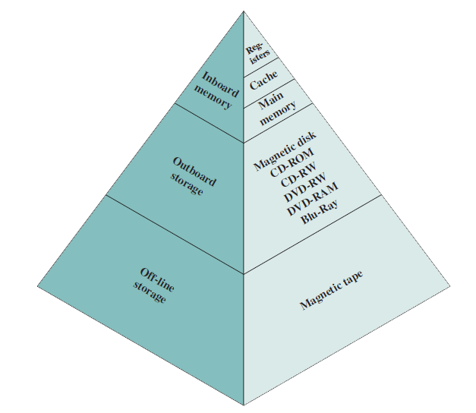
MEMORY HIERARCHY

Slide 31
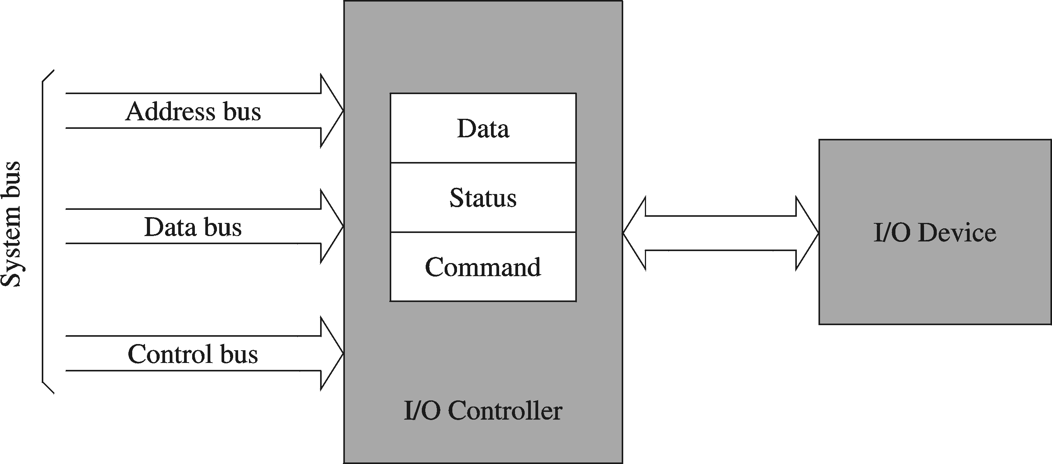
I/O CONTROLLERS
I/O devices are interfaced via an I/O controller
  I/O controller uses the system bus to communicate with processor
  I/O controller takes care of low-level operation details

Slide 32
REFERENCE
Chapter # 1
  Computer Organization and Architecture
  William Stallings
Chapter # 2
  Assembly Language for x86 Processors
  Kip R. Irvine

